Slide 1
Linguistic Changes in Foreign Policy Political Discourse
Kayla Jordan Thesis Defense
Missouri State University

Slide 2
Introduction
Foreign policy - the choices a nation makes in relation to entities outside the nation
Kaufman (2010)
Role of the legislative
Phelps & Boylan (2002), Ansolabehere & Jones (2010), Grimmer (2010), Kriner & Shen (2014)

Slide 3
Language
Source of abundantly available data
Important to psychological constructs
Attentional focus
Group cohesion
Social status
Tausczik & Pennebaker (2009)

Slide 4
Purpose and Hypotheses
To use word frequency analysis to understand U.S. congressmen and women’s positions and attitudes toward U. S. foreign policy with Iraq, Iran, and North Korea
To examine linguistic changes in the foreign policy discourse in Congress
Hypothesis 1: Complex thinking, cognitive processing, and psychological distancing will increase following acts of aggression perpetrated by Iraq, Iran, and North Korea.
Hypothesis 2: Categorical thinking, honesty, and status will change over time as a function of party affiliation.

Slide 5
LIWC
82 language categories
Content and function words
Dictionary includes ≈ 4500 words and word stems
Each word is categorizes in one or more categories
For each category, total number of occurrences of all the words in that category is computed as a percentage of the total number of words in the document.

Slide 6
Metalinguistic Constructs

Slide 7
Sample Size-Senate
Senate (N = 1024)
Word Count
M = 1393.93 (SD = 1050.99)
143 unique senators
Party speeches
522 by Democrats
468 by Republicans
Topic
Iraq (n = 943)
Iran (n = 57)
North Korea (n = 24)
Average time in office
M =17.67 (SD = 10.88)

Slide 8
Sample Size-Senate
Senate (N = 1024)
Word Count
M = 1393.93 (SD = 1050.99)
143 unique senators
Party speeches
522 by Democrats
468 by Republicans
Topic
Iraq (n = 943)
Iran (n = 57)
North Korea (n = 24)
Average time in office
M =17.67 (SD = 10.88)

Slide 9
Sample Size-House of Representatives
House of Representatives (N = 3512)
Word Count
M = 745.64 (SD = 946.08)
570 unique representatives
Party speeches
2100 by Democrats
1412 by Republicans
Topic
Iraq (n = 3315)
Iran (n = 172)
North Korea (n = 25)
Average time in office
M =10.67 (SD = 8.32)

Slide 10
Sample Size-Foreign Affairs Committee
Foreign Affairs Committee (N = 254)
Word Count
M = 1111.30 (SD = 1591.95)
94 unique members of Congress
Party speeches
144 by Democrats
110 by Republicans
Topic
Iraq (n = 24)
Iran (n = 134)
North Korea (n = 96)
Average time in office
M =12.82 (SD = 9.10)

Slide 11
Data Analysis
Non-linear trends
Nonparametric regressions with smoothing splines
Smoothing parameters
Cross-Validation
Differences between time points and parties
Significant z difference of 2.71
Bonferroni corrected α = .003
Models
Six models for complex thinking, cognitive processing, & psychological distancing
Separate models for Iraq and Iran/North Korea
Separate lines for overall, Democrats, and Republicans
Six models for categorical thinking, honesty, & status
Separate models for Iraq and Iran/North Korea
Separate lines for Democrats and Republicans

Slide 12
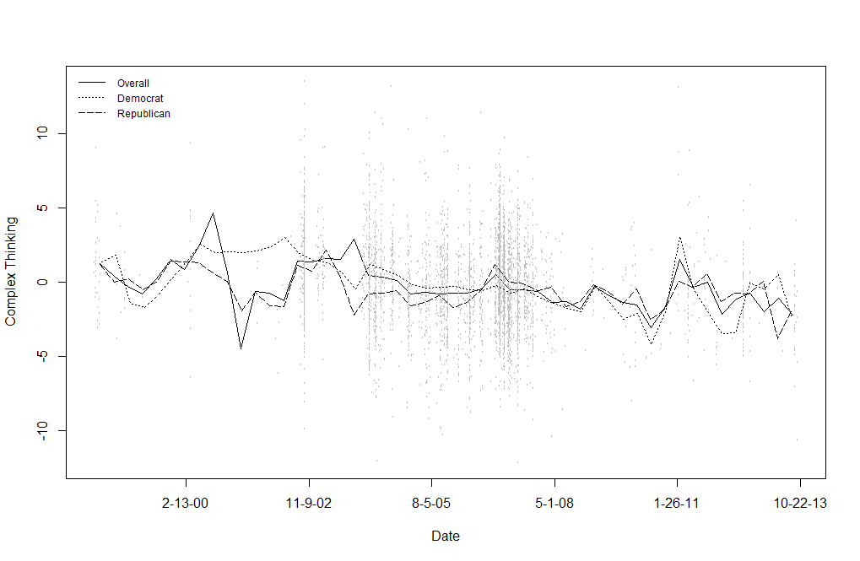
Complex Thinking - Iraq

Slide 13
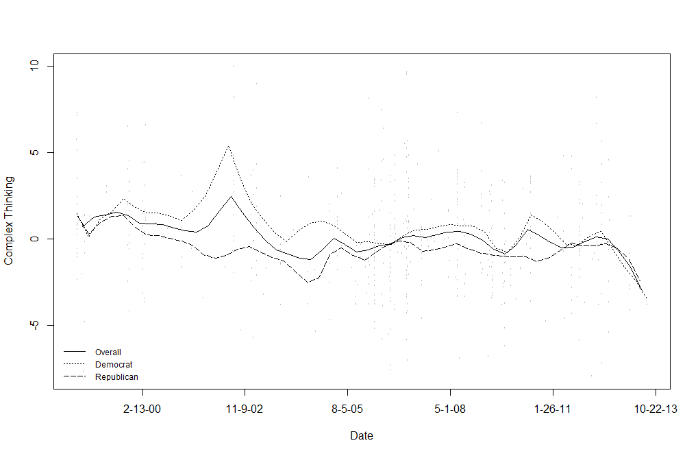
Complex Thinking – Iran & North Korea

Slide 14
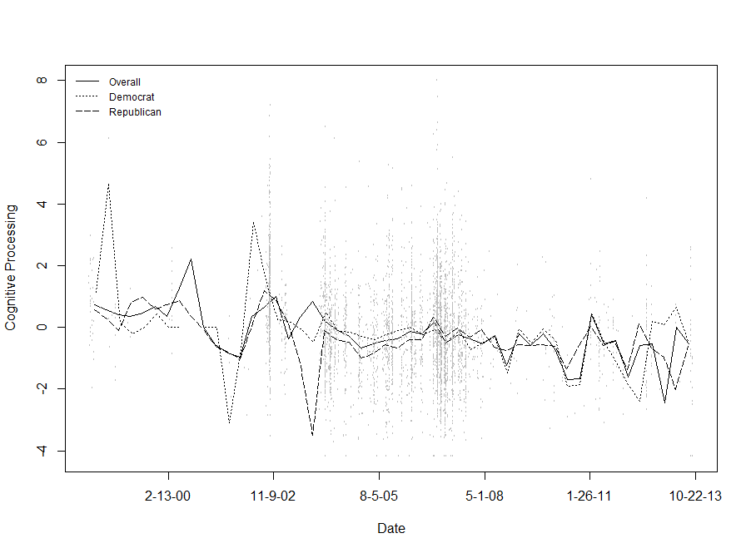
Cognitive Processing - Iraq

Slide 15
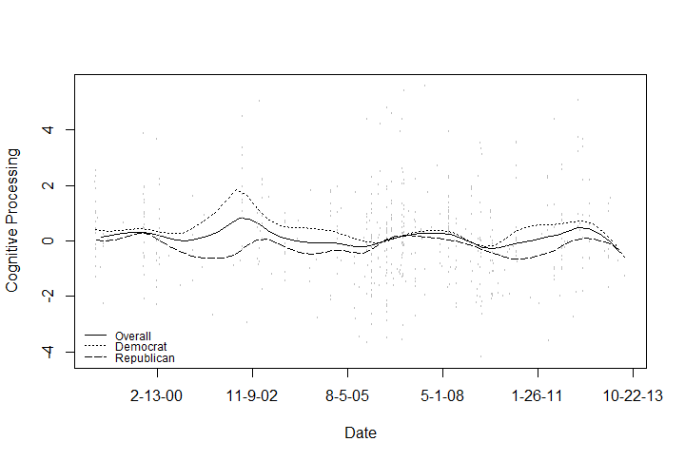
Cognitive Processing – Iran & North Korea

Slide 16
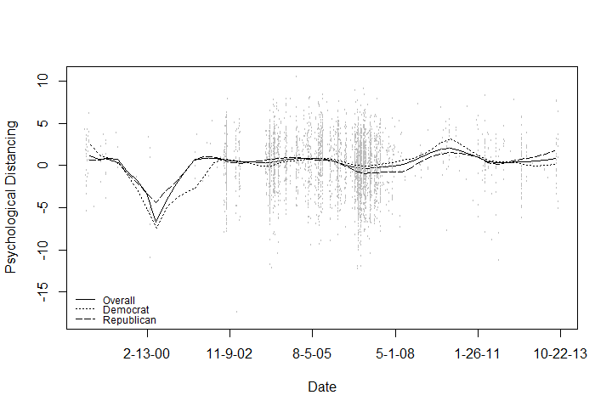
Psychological Distancing - Iraq

Slide 17
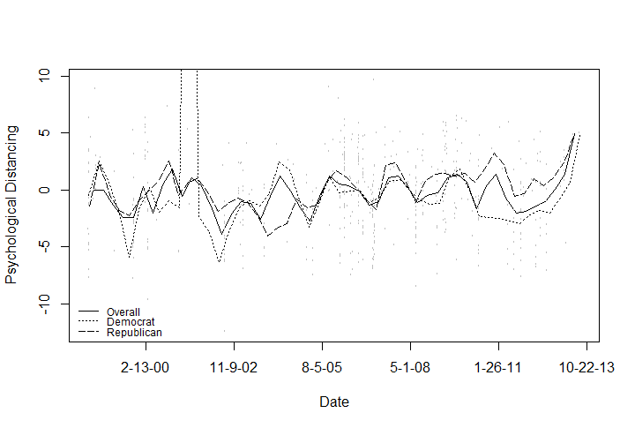
Psychological Distancing – Iran & North Korea

Slide 18
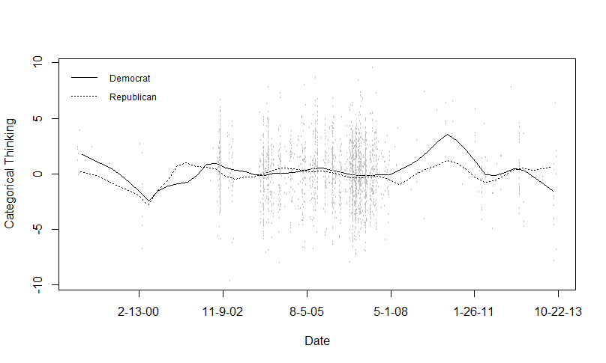
Categorical Thinking - Iraq

Slide 19
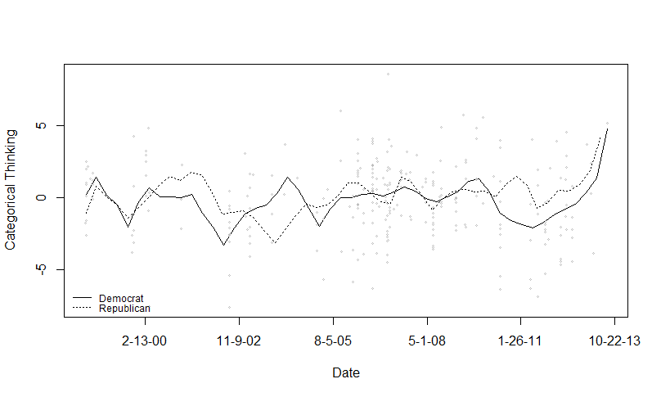
Categorical Thinking – Iran & North Korea

Slide 20
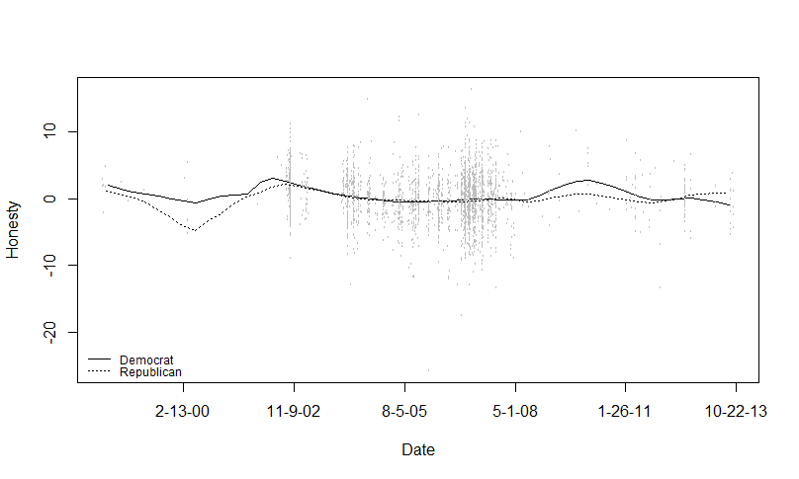
Honesty - Iraq

Slide 21
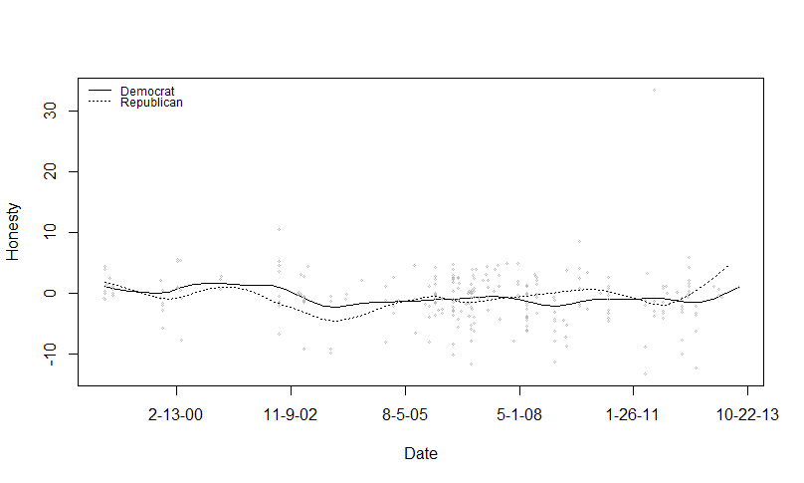
Honesty – Iran & North Korea

Slide 22
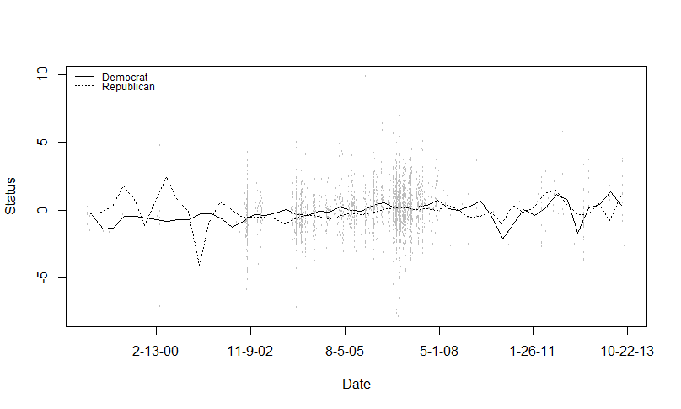
Status - Iraq

Slide 23
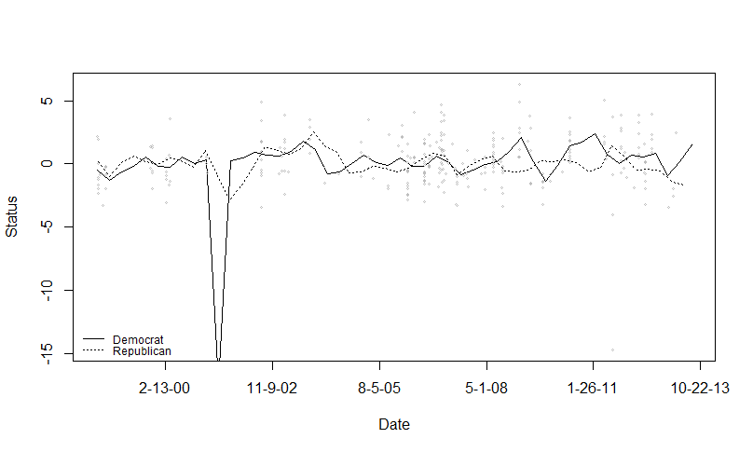
Status – Iran & North Korea

Slide 24
Discussion - Iraq
1998-2001
Decreased distancing 1998 – mid 2000
Operation Desert Fox
Increased distancing mid 2000 – late 2000
Presidential Election
Increased complex thinking mid 2000 – mid 2001
Presidential Election
Decreased complex thinking mid 2001 – late 2001
9/11

Slide 25
Discussion – Iran & North Korea
1998-2007
Decreased distancing mid 1998 to mid 1999
North Korea missile test-fire
Increased distancing mid 1999 to late 2000
Presidential election
Decreased distancing mid 2001 to late 2002
9-11
Increased distancing late 2002 to mid 2004
Iran violation of international nuclear agreements
Decreased complex thinking mid 2002 to mid 2004
Iran violation of international nuclear agreements
Decreased distancing mid 2004 to early 2005
Iran suspended nuclear program
Increased distancing early 2005 to late 2007
Iran restarted nuclear program
North Korea broke several international agreements

Slide 26
Discussion – Iran & North Korea
2010-2013
Decreased complex thinking
Increased psychological distancing
Arab Spring
Stricter Iranian sanctions
North Korea plans for satellite

Slide 27
Discussion – Party Differences
Complex Thinking – Iraq
2001 – Presidential Election
Democrats more complex
2011 to 2012 – Arab Spring
Democrats more complex
Complex Thinking – Iran & North Korea
2001 to 2004 – 9-11
Democrats more complex
Cognitive Processing – Iraq
1998 – Operation Desert Fox
Democrats more processing
Psychological Distancing – Iran & North Korea
Many differences

Slide 28
Discussion – Party Differences
Categorical thinking – Iran & North Korea
2011 – Arab Spring
Republicans more categorical
Honesty – Iraq
1999-2000 – Presidential election
Democrats more honest
Honesty – Iran & North Korea
2013 – Arab Spring
Republicans more honest
Status – Iraq
2000 – Presidential Election
Republicans higher status
2001 - ?
Democrats higher status
Status – Iran & North Korea
Mid 2001 – Presidential election
Republicans higher status

Slide 29
Conclusion
Three major events:
2000 Presidential Election
9-11
Arab Spring
Congressional language
High variation
Large number of changes
Does seem to have some connection to real world events which could aid in the understanding of foreign policy decision making

